Slide 1
An Internet of Things Project
By Antonio DiTommaso
Class: 744-01
Date: 2018-05-09

Slide 2
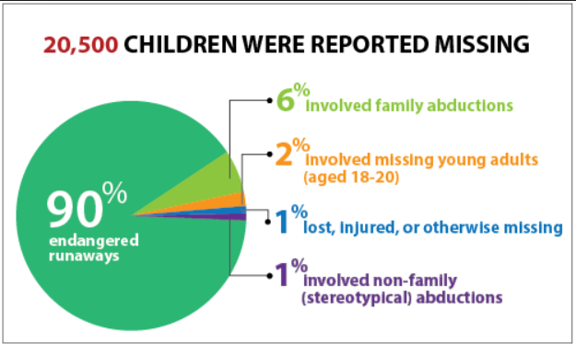
Statistics on Child Abductions
2016 Data from National Center for Missing and Exploited Children (NCMEC)
20,500 children were reported missing
90% of missing children were endangered runaways
6% of missing child cases involved family abductions
2% of cases involved missing young adults, aged 18-20
1% of missing children were lost, injured or otherwise missing
1% of cases involved non-family (stereotypical) abductions
Source: www.kidguard.com

Slide 3
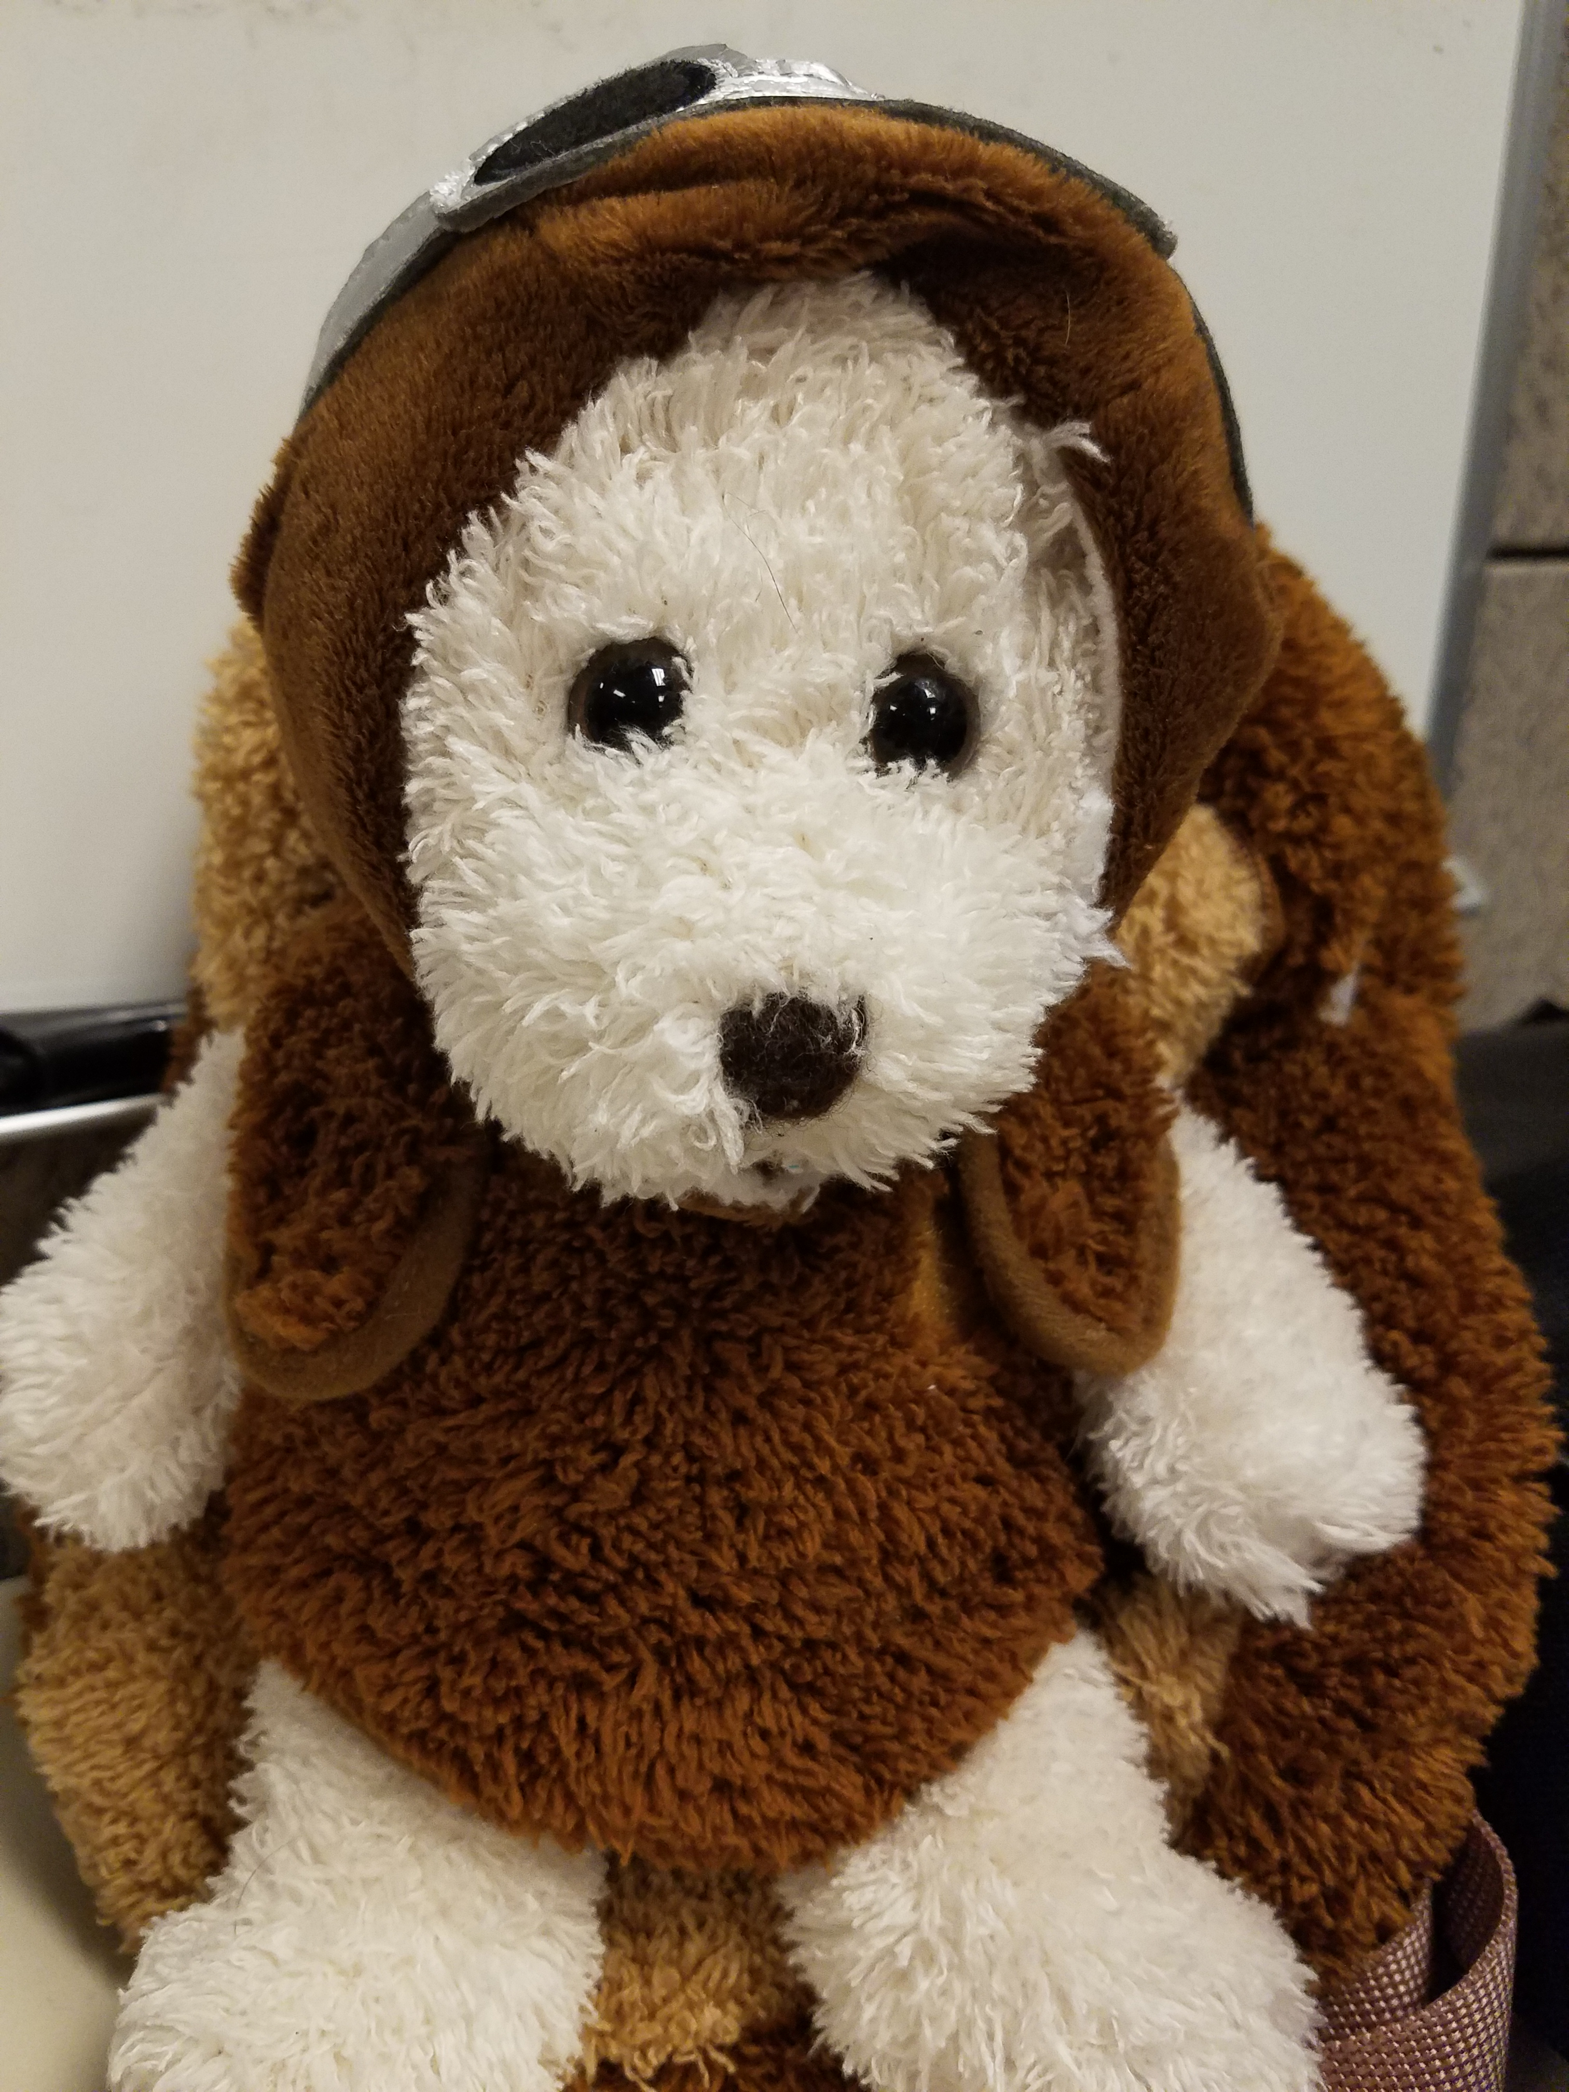
SOLUTION
SAFETY BEAR
*REFERENCE Material in building Safety Bear:
https://www.particle.io/products/hardware/asset-tracker/
https://www.hackster.io/Richa1/kid-tracker-1b58c9

Slide 4
The Idea of Safety Bear
Safety BEAR: It is a GPS location device with a Particle Photon as a core
It sends GPS Longitude and Latitude Coordinates of your child location to your cellphone
Website controlled to turn off and on GPS location
Has a Button on device to send GPS location when activated
Has a light to indicate if GPS is on or off
Flashes red if on
Flashes green when off
Uses IFTTT to get data from Particle Photon and send it to your cell phone
Data is published by the Particle every 5 to 10 Seconds

Slide 5


IFTTT Activities
IFTTT Send GPS Location to Phone
IFTTT Send GPS Location to Google Drive – testing

Slide 6
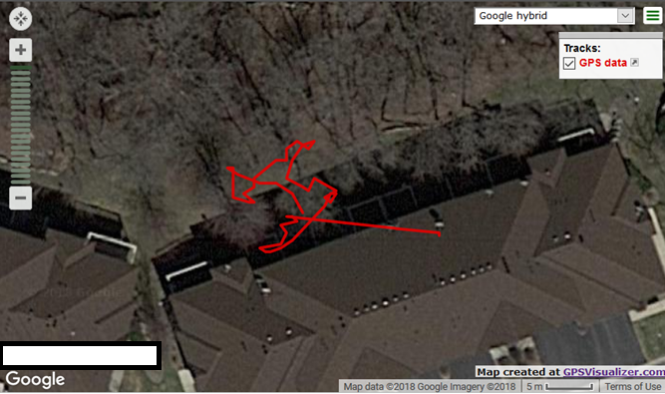
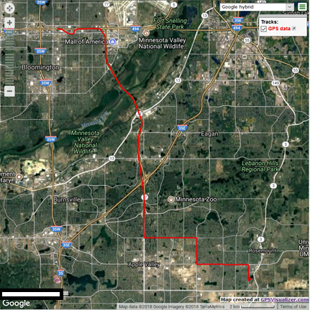
Verification of GPS working
Wi-Fi around the house
Wi-Fi connection to phone

Slide 7
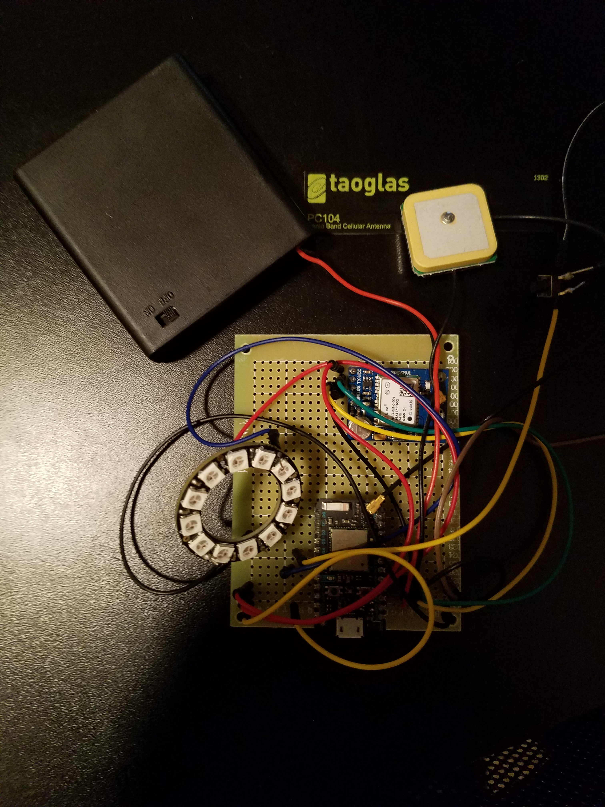
What’s inside Safety Bear

Slide 8
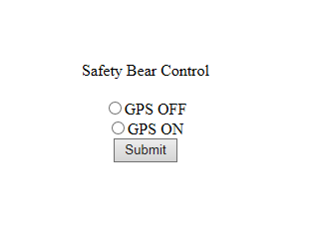
DEMO

Slide 9
limitations
Safety Bear is Wi-Fi connection only
Safety Bear might be too Bulky compared to other market devices
Safety Bear Current build is not cost effective compared to other market devices
Safety Bear might not be the most convenient market value GPS locater
Safety Bear runs off of IFTTT, and sometimes the app responds erratic

Slide 10
Future Expansion of Safety Bear
Add Cellular connection to allow Safety Bear to send GPS locations anywhere
Condense Safety Bear into a more marketable solution
Upgrade Webpage to Android App to allow instant GPS location results
Get away on relying on IFTTT to send SMS to cellphone
***Reduce Price of materials used***

Slide 11
bill of material
Particle Maker Kit $89.00
Eztronics Corp Ublox NEO-6M GPS Module Aircraft Flight Controller $16.89
Adafruit 12 RGB LED Neopixel Ring $7.50
Taoglas PC104.07.0165C High Performance Cellular $10.00
Bear Bookbag $20.00
SUBTOTAL
$143.39

Slide 12
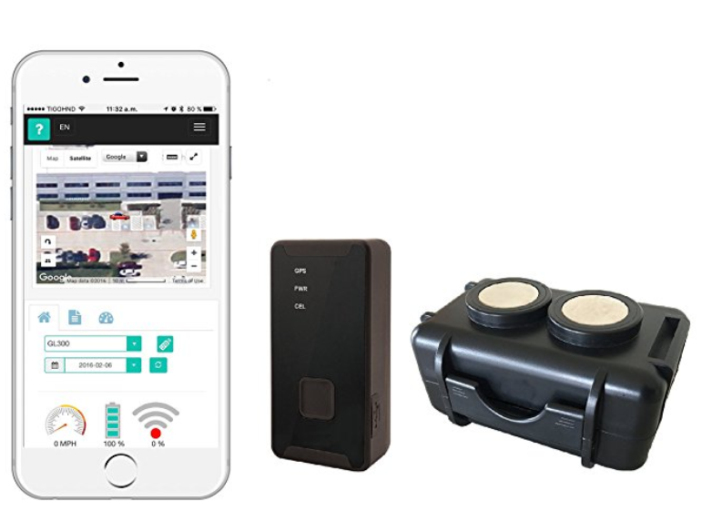
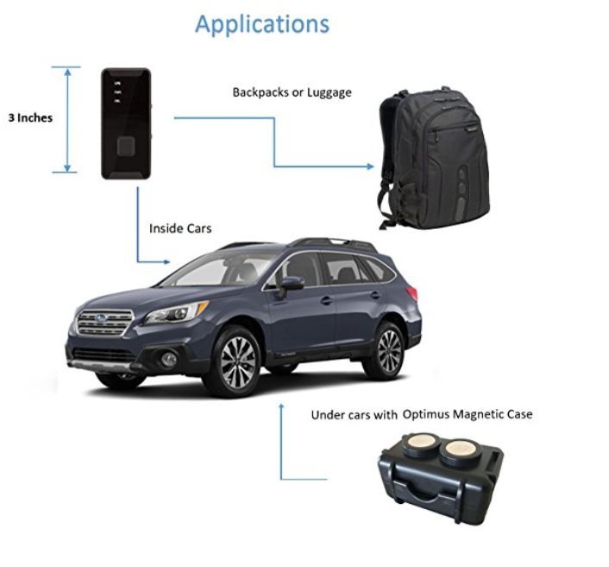
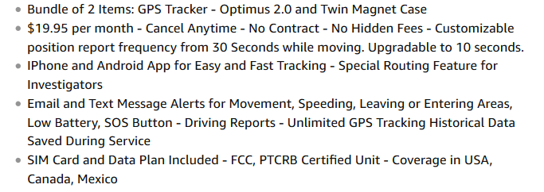
Child GPS Device – Current Market
GPS Tracker - Optimus 2.0 Bundle with Twin Magnet Case
SUBTOTAL $79.95
Source: www.amazon.com

Slide 13
Summary
Safety Bear Works on Wi-Fi only
Safety Bear GPS is really accurate
Safety Bear sends GPS signal every 5 to 10 seconds
Safety Bear is currently has a high cost
Safety Bear internal components are too bulky
Safety Bear was fun to Produce
Keeping your kids safe, priceless
Seeing your classmate in Safety Bear, also priceless

Slide 14
QUESTIONS

Slide 15
Citations
Gamble, H. (2018, January 11). What You Should Know About Child Abductions. Retrieved April 08, 2018, from https://www.kidguard.com/prevent-child-abduction-kidnapping-and-missing-children/what-you-should-know-about-child-abductions/
(n.d.). Retrieved May 08, 2018, from https://www.amazon.com/GPS-Tracker-Optimus-Bundle-Magnet/dp/B01KKVKQ66/ref=sr_1_2_sspa?ie=UTF8&qid=1525826000&sr=8-2-spons&keywords=child gps tracker&psc=1

